Slide 1


Welcome To BrandifyX
Building Brands , Boosting Digital
BrandifyX

Slide 2
About BrandifyX: Our Agency Focus
CRAFTING UNIQUE DIGITAL EXPERIENCES FOR BRANDS
At BrandifyX, we’re more than just a digital marketing agency — we’re your brand’s digital growth partner. Founded with a passion for creativity and strategy, our mission is to help businesses thrive in the digital world. From startups to established brands, we craft tailored marketing solutions that spark engagement, drive traffic, and deliver real results.
We specialize in a wide range of services including Web Development, SEO, UI/UX Design, Video Editing, Social Media Management, Email Marketing, Content Marketing, and Graphic Design. Every service we offer is powered by innovation, backed by experience, and aligned with your business goals.
BrandifyX

Slide 3
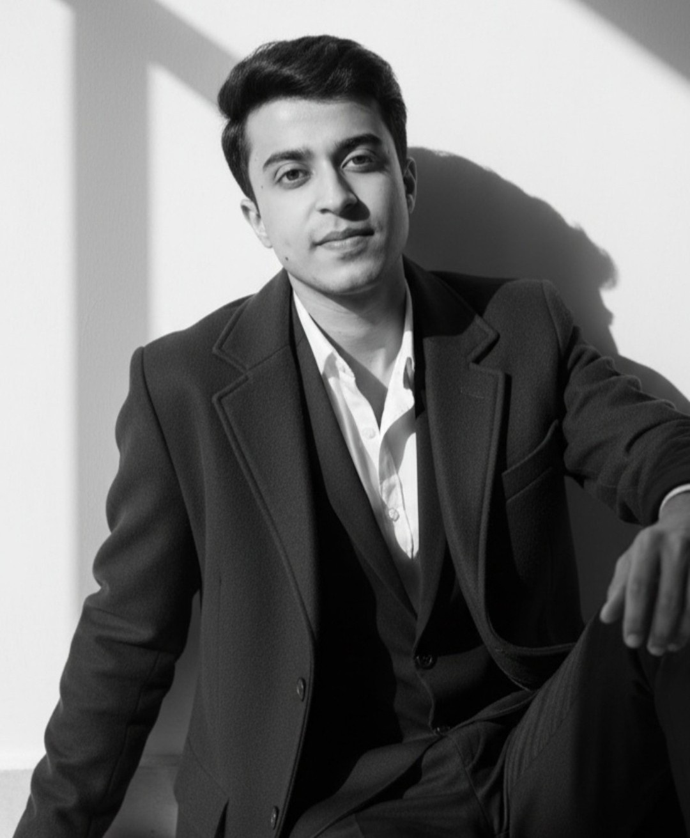
Founder
Meet Kavesh Jangid, Our Visionary Leader
Kavesh is a passionate digital creator and entrepreneur dedicated to empowering brands through innovative marketing strategies and cutting-edge digital solutions.

Slide 4
Our Mission and Vision
OUR MISSION
OUR VISION
Helping businesses grow digitally through impactful strategies that leverage creativity, technology, and data-driven insights, ensuring sustainable growth and success.
To become a trusted partner for brands worldwide, recognized for our innovative solutions and commitment to driving transformative results in the digital landscape.
BrandifyX

Slide 5
Our Services
WEB DEVELOPMENT
APP DEVELOPMENT
We create responsive websites that enhance user experience and drive engagement.
Our team develops intuitive mobile applications tailored to meet your business goals.
SEO
SOCIAL MEDIA MANAGEMENT
We implement effective SEO strategies to boost your visibility and organic traffic.
Our experts manage your social presence, fostering engagement and community growth.
GRAPHIC DESIGNING
We design stunning visuals that capture your brand's essence and attract your audience.
BrandifyX

Slide 6
Our Services
UI/UX DESIGNING
VIDEO EDITING
Creating intuitive and engaging user interfaces for optimal user experiences.
Producing high-quality video content that resonates with target audiences effectively.
CONTENT CREATION
UGC
Developing compelling content strategies to enhance brand storytelling and engagement.
Leveraging user-generated content to build community and foster brand loyalty.
BRANDING & IDENTITY
PERFORMANCE MARKETING
Crafting unique brand identities that reflect values and connect with audiences.
Implementing data-driven marketing strategies to maximize conversions and ROI.
BrandifyX

Slide 7
Why Choose Us ?
CREATIVE APPROACH
RESULT-DRIVEN
Our creative approach ensures that every project is tailored to reflect your brand's unique identity, using innovative solutions to engage your audience and stand out in the market.
We implement result-driven strategies focused on measurable outcomes, ensuring that every campaign effectively enhances your brand's visibility and drives conversions while providing maximum ROI.
CLIENT-FIRST MINDSET
SCALABLE SOLUTIONS
At BrandifyX, we prioritize a client-first mindset, fostering strong partnerships through clear communication, collaboration, and a commitment to understanding and fulfilling your specific business needs.
Our scalable solutions adapt to your business's growth, offering flexible resources and strategies that evolve as your brand expands, ensuring long-term success in an ever-changing digital landscape.
BrandifyX

Slide 8



Recent Projects
DNM INTERIOR SOLUTIONS LLP
MARUDHAR INDUSTRIES
DIVINE STORAGE SYSTEMS
www.dnminteriorsolutions.in
www.marudharindustries.com
www.divinestoragesystems.in
BrandifyX

Slide 9
Client Testimonials
MANISH BHADRECHA
ASHISH UTTAM
(CEO at DNM Interior Solutions LLP)
(Manager at Marudhar Industries)
They brought our vision to life! The BrandifyX team created a custom website that reflects our brand identity perfectly. The layout, animations, and user flow are just brilliant!"
SEO-friendly, mobile-optimized, and stunning—what else could we ask for? BrandifyX nailed every technical and design detail for our website. We’re proud to showcase it!"
ABDUL CHOUDHARY
MUKESH JANGID
(CEO at Eagle Storage Solutions)
(CEO at Diverse Creation Private Limited)
"Best web development experience we’ve had. They were fast, communicative, and delivered beyond expectations. Our e-commerce site now feels premium and user-friendly."
Highly professional and creative. We hired BrandifyX to redesign our old website, and they delivered a clean, modern design with seamless navigation. We've already seen a boost in conversions!"
BrandifyX

Slide 10
Our Process
STRATEGY
DESIGN
DEVELOPMENT
We analyze market trends and define goals to create tailored marketing strategies for optimal impact and engagement.
Our creative team crafts visually stunning and user-friendly designs that resonate with target audiences and elevate brands.
We bring ideas to life using cutting-edge technology, ensuring seamless functionality and exceptional user experiences across all platforms.
BrandifyX

Slide 11
Get in Touch
We look forward to hearing from you and collaborating!
WEBSITE
www.brandifyx.in
EMAIL
brandifyx007@gmail.com
PHONE CONTACT
+91 8619599284
BrandifyX

